Slide 1

Transformer
小组成员: 田雨
吕嘉
樊睿文

Slide 2
1.
Introduction
CONTENTS
目录
2.
Model structure
3.
Application
4.
Summary

Slide 3
Introduction

Slide 4
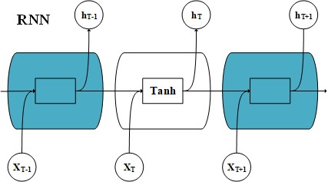
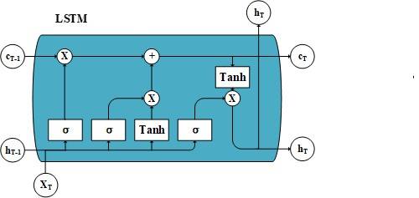
Before Attention appeared
Although RNN,LSTM structures have achieved good results.But there are still many disadvantages
1. In the RNN, LSTM model, the output produced by the input will be calculated as the input at the next moment. So the model has no parallelism
2. The long-range dependence of RNN and LSTM models is not enough
Notes:
RNN对一个状态的计算必须基于前一个状态，所以没有并行性。
LSTM中的 C(T-1)表示memory from previous block , h(T-1)表示output from previous block ,
C(T)表示memory from current block , h(T)表示output from current block ，其相对与RNN来讲，具备上一模块的“记忆”信息。
但它们共同的问题在于无法对整个序列产生联系，而attention mechanism则解决了这一问题。

Slide 5
Before Attention appeared
Seq2Seq generates a general processing model for another sentence (or chapter) from one sentence. The encoder and decoder parts can use RNN, LSTM,CNN structures.
Y1
Y2
Y3
Encoder
Semantic Encoding C
Decoder
X1
X2
X3
X4

Slide 6
Before Attention appeared
Encoder will encode the input sentence X into a fixed-length hidden vector (semantic encoding c), which will cause the hidden vector to not completely represent the information of the input sentence X.
Decoder will decode the content of semantic encoding c and outputs it as a sequence
Y1
Y2
Y3
Encoder
Semantic Encoding C
Decoder
X1
X2
X3
X4
Notes:
造成这个情况的两个可能性
1.隐向量的大小有限，无法表示语义丰富的句子
2.由于RNN类网络有长距离依赖的问题，网络会更加看中句子后面的信息
The Encoder-Decoder framework will have an obvious disadvantage.

Slide 7
Disadvantage of Seq2seq
1.The size of the hidden vector is limited, and it cannot represent semantically rich sentences, which will cause the information carried by the input content to be diluted and overwritten by the information input later, and the longer the input sequence, the more serious.
2. Each word of the input sentence is given the same weight, so there is no discrimination. For example, in machine translation, it is often that one or several words are input corresponding to one or more words that are output, which will reduce the model performance.
Y1
Y2
Y3
Encoder
Semantic Encoding C
Decoder
X1
X2
X3
X4
Notes:
1.隐向量的大小有限，无法表示语义丰富的句子,会造成先输入的内容携带的信息会被后输入的信息稀释覆盖掉，输入序列越长就越严重。
2.输入句子的每个词赋予相同权重，这样做没有区分度，比如在机器翻译中往往是输入一个或几个词对应于输出的一个或几个词，会模型性能下降。

Slide 8
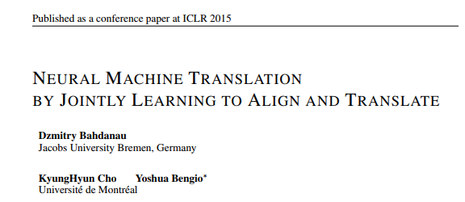
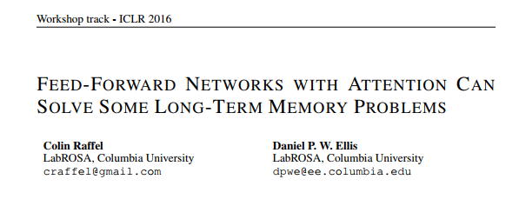
Introduction of Attention
In order to solve the problem of Seq2Seq.
In 2015 ICLR,Some thoughts on attention were put forward in article "NEURAL MACHINE TRANSLATION BY JOINTLY LEARNING TO ALIGN AND TRANSLATE "
In 2016 ICLR, Attention was officially proposed in article"FEED-FORWARD NETWORKS WITH ATTENTION CANSOLVE SOME LONG-TERM MEMORY PROBLEMS "

Slide 9
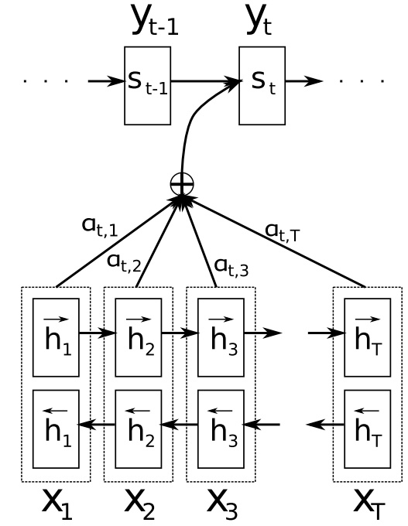
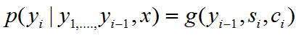
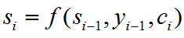
Calculation of Attention Mechanism
We define each conditional probability as:
where S_{i} is an RNN hidden state for time i,computed by
Notes:
首先我们利用RNN结构得到encoder中的hidden state [公式]

Slide 10
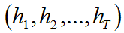
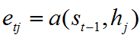
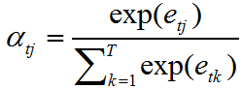
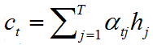
General form of attention
we use the RNN structure to get the hidden state in the encoder
Notes:
1、Assuming the hidden state of the current decoder is S_{t-1}, we can calculate the correlation between each input position j and the current output position
2、a is a correlation operator, such as some multiplication forms, weighted point multiplications, additions and other calculation forms
3、For e_{tj} the value of attention for softmax operation
4、Using a_{tj} we can perform weighted summation to get the corresponding context vector

Slide 11
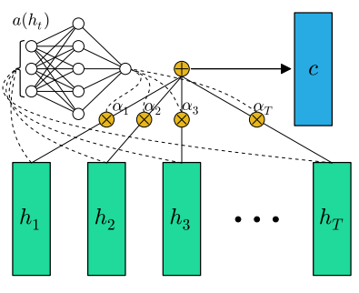
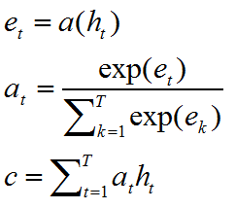
Feed-Forward Attention
The above attention is simplified in feed-forward attention and applied to sequence embedding tasks as follows:
Instead of a series of context vectors, we generate a context vector

Slide 12
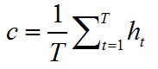
Feed-Forward Attention
Feed-forward attention can be used for sequence embedding when the sequence length T is varies across sequences, it can be seen as an extreme oversimplification of attention, would be to compute c as the unweighted average of the state sequence
Feed-forward networks with attention follows that by using this simplified form of attention,it can be more effective than RNNs.

Slide 13
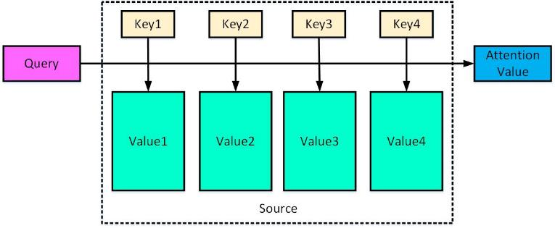
Attention Mechanism
The constituent elements in Source are regarded as a series of <Key, Value> structures.
The attention model is to learn the importance of each element from the sequence, and then combine the elements according to the importance.
Notes:
The constituent elements in Source are regarded as a series of <Key, Value> structures.
At this time, given an element Query in Target, by calculating the similarity or correlation between Query and each Key,
each Key corresponds to The weight coefficient of Value, and then weighted summing of Value, then the final Attention value is obtained.

Slide 14
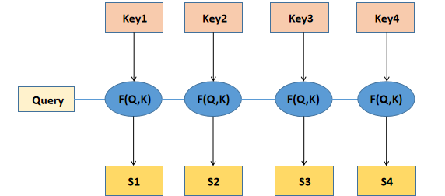
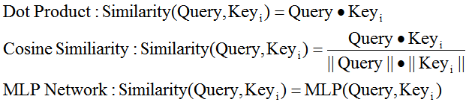
Steps to calculate Attention
In the first stage, different functions and computer systems are introduced according to the similarity between Query and a key calculation.
Common methods include:
1. finding the vector dot product of the two
2. finding the vector cosine similarity of the two
3. introducing Additional neural network to evaluate

Slide 15
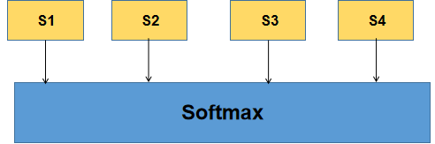
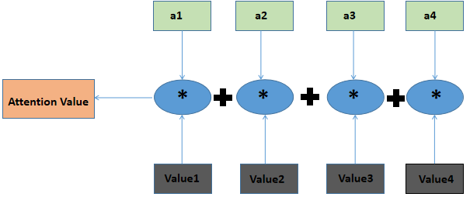
Steps to calculate Attention
In the second stage, SoftMax is introduced. On the one hand, normalization can be performed, and on the other hand, the weight of important elements can be highlighted through SoftMax.

Slide 16
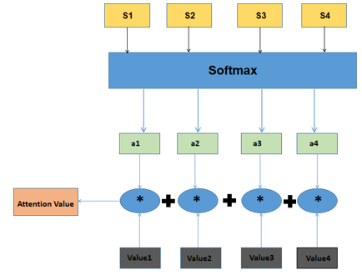
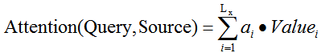
Steps to calculate Attention
The third step takes the calculation result of the previous step as the corresponding weight coefficient, and then performs weighted sum to obtain the Attention value.

Slide 17
Introduction of Self-Attention
Self-Attention mechanism is the Attention mechanism that occurs between elements within the Source or between elements within the Target. It can also be understood as the special case of Target = Source Attention computer system.
Model | Transformer | LSTM | CNN
Basic mechanism | Self-Attention | RNN | CNN
parallelism | Yes | No | Yes
Long-range dependence | Yes | Yes(but not enough) | No
Notes:
1、Self-Attention is also often referred to as intra Attention.

Slide 18
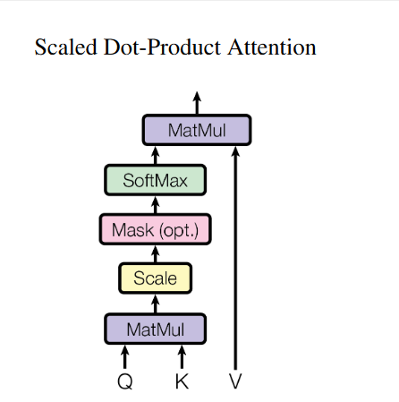
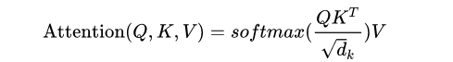
Comparison of General Attention and Self-Attention
General Attention
Self-Attention
Notes:
1、Self-Attention is also often referred to as intra Attention.

Slide 19
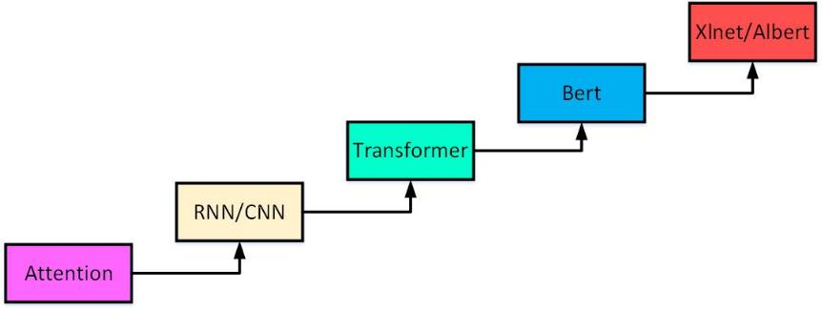
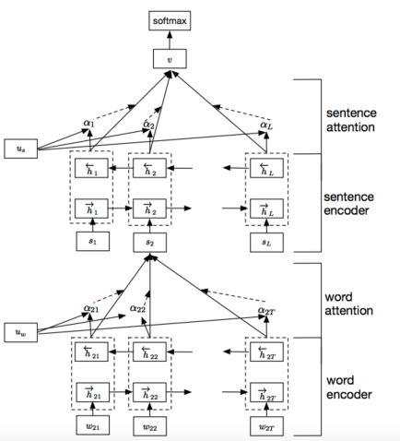
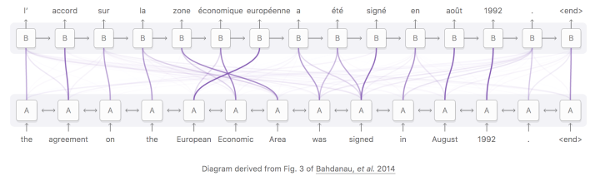
Applicantion of Attention in NLP
Attention in Langauge model
Text Classification
Machine Translation

Slide 20
Model structure

Slide 21
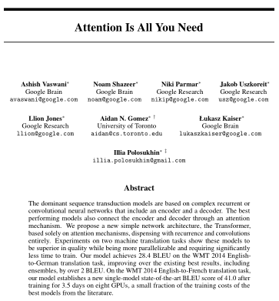
Introduction
Transformer is a model for seq2seq task proposed by Google researchers in the article "Attention Is All You Need" in 2017 NIPS.
It does not have the loop structure of RNN or the convolution structure of CNN.
It is obtained in tasks such as machine translation. Certainly improved.

Slide 22
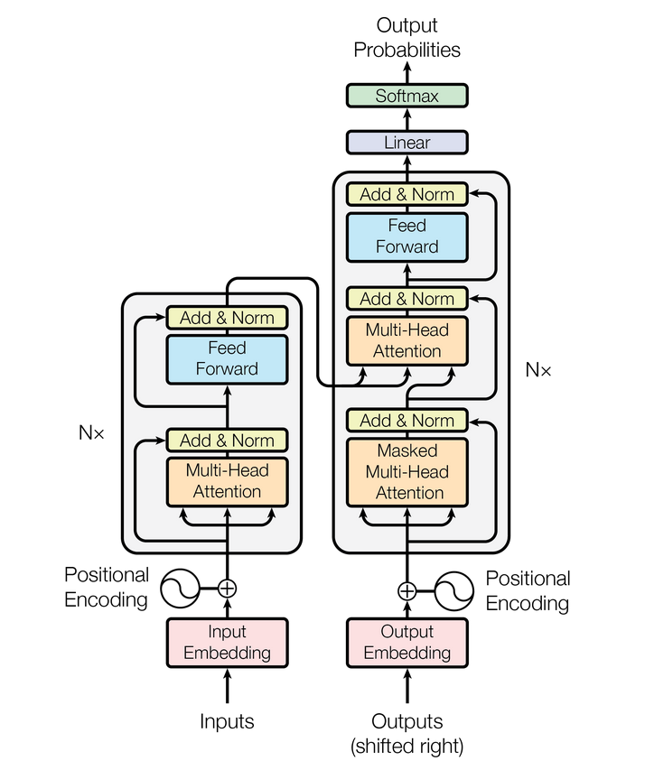
Model structure
The Transformer contains four parts.
The first is Input.
The second is Encoder.
The third is Decoder.
The fourth is Output.
Notes:
input enbedding和output embedding都记为input。

Slide 23
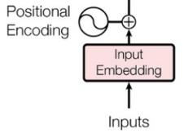
Input
The input has two parts : input embedding and positional encoding.
Input embedding turns words into vectors.
Positional encoding encodes the fact that words appear in different positions.
Notes:
encoder的输入有两部分组成。

Slide 24
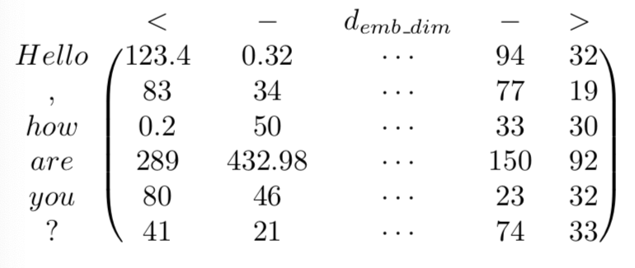
Word embedding
Given a sentence in a corpus : “ Hello, how are you?”
The first step is to tokenize it:
“ Hello, how are you?” → [“Hello”, “,” , “how”, “are”, “you”, “?”]
Then , we will get the word vectors matrix.
Notes:
针对给定的一句话，“Hello,how are you?”。第一步是对这句话进行分词。然后得到每个词在词汇表中的位置。根据这些位置索引就可以找到对应的词向量，生成词向量矩阵。向量的维度是512。
需要注意的是，对句子进行分词时，有时需要填充以使得输入序列具有相同的长度。例如，第一个句子由6个词，第二个句子有9个词，那么第一个句子需要填充三个词。

Slide 25
Positional encoding
The Transformer model does not use the RNN structure, it cannot capture the sequence of the sequence, so other mechanisms are needed to transmit the position information to the encoding part.
1. Count by text length
0 | 1 | 2 | 3 | 4 | 5 | ...... | 497 | 498 | 499
2. Text length is normalized for each position
short text
0/99 | 1/99 | 2/99 | 3/99 | 4/99 | ...... | 96/99 | 97/99 | 98/99 | 99/99
long text
0/999 | 1/999 | 2/999 | 3/999 | 4/999 | ...... | 996/999 | 997/999 | 998/499 | 999/999
Notes:
1、Pos代表单词在句子中的位置,如how位于第2位。2i表示偶数维度，2i+1表示奇数维度，论文中dmodel=512。
2、位置编码可以通过训练得到，也可以使用某种公式计算得到。在 Transformer 中采用了后者，因为论文后面比较了这两种方式，得到的结果是相同的。
3、同时，使用公式能够使模型适应比训练集里面所有句子更长的句子，假设训练集里面最长的句子是有 20 个单词，突然来了一个长度为 21 的句子，则使用公式计算的方法可以计算出第 21 位的 Embedding。因为PE(pos+k) 可以用 PE(pos) 计算得到。
4、计算出input embedding和positional encoding之后，将这两个矩阵相加，就可以得到encoder的输入矩阵X。

Slide 26
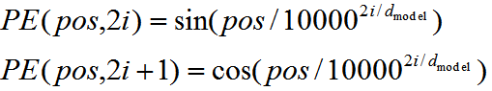
Positional Encoding
Requirements for position encoding:
1. It is necessary to prevent the encoding from being irrelevant to the length of the text.
2. Need to reflect a certain sequence relationship.
3. Need to reflect the difference of the same word in different positions.
So the sine cosine function was introduced.
Expanding the above formula gives the following form:
Notes:
1、Pos代表单词在句子中的位置,如how位于第2位。2i表示偶数维度，2i+1表示奇数维度，论文中dmodel=512。
2、位置编码可以通过训练得到，也可以使用某种公式计算得到。在 Transformer 中采用了后者，因为论文后面比较了这两种方式，得到的结果是相同的。
3、同时，使用公式能够使模型适应比训练集里面所有句子更长的句子，假设训练集里面最长的句子是有 20 个单词，突然来了一个长度为 21 的句子，则使用公式计算的方法可以计算出第 21 位的 Embedding。因为PE(pos+k) 可以用 PE(pos) 计算得到。
4、计算出input embedding和positional encoding之后，将这两个矩阵相加，就可以得到encoder的输入矩阵X。

Slide 27
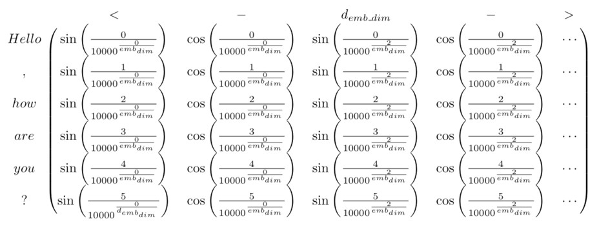
Positional Encoding
It can be seen that, for a certain dimension 2i or 2i + 1 of the position vector at the position of pos + k, it can be expressed as a combination of PE (pos) and PE (k), and it can also express the embedding of the relative position.
Notes:
可以看出，对于位置向量在pos + k位置的特定维2i或2i +1，可以表示为PE（pos）和PE（k）的组合，也可以表示为 相对位置的嵌入。

Slide 28
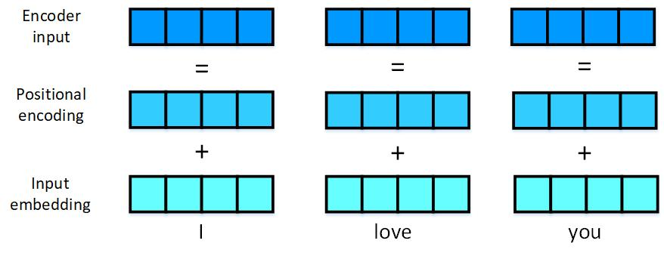
Input of Transformer
I
love
you
Input X

Slide 29
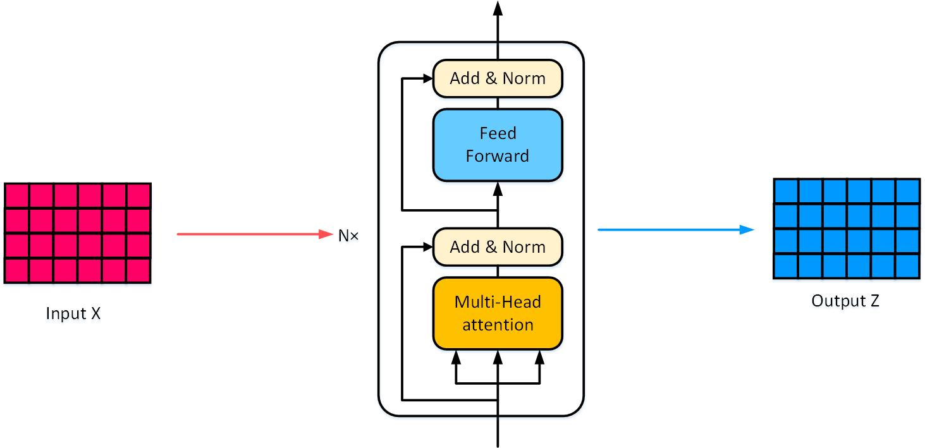
Encoder
The input matrix X is transformed into a hidden state matrix after passing through the encoder.
Notes:
1、Encoder具有6层循环，每一层的输入为上一层的输出，第一层的输入为Input的X。
2、Encoder具有两个子层，multi-head attention和feed forward，每个子层后连接一个层标准化函数。

Slide 30
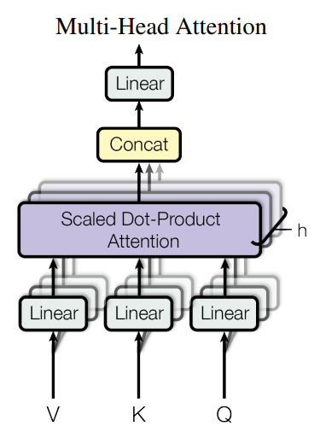
Multi-head attention
In the previous step, we know how to obtain the output matrix Z through Self-Attention calculation, and Multi-Head Attention is formed by the combination of multiple Self-Attention.
Notes:
1、在muiti-head attention中，V、K、Q通过输入X分别乘以三个不同矩阵获得，与self-attention的V、K、Q相同。
2、从下向上看，第一层的Linear表示将输入的V、K、Q做8次不同的线性映射，就可以得到8组V、K、Q。然后进行8次平行的attention计算，得到8个输出，将这8个输出连接起来后再做一次线性变化，即可得到muiti-head attention的最终输出。
3、muiti-head attention可以起作用的最重要的一点是词向量的生成已经在一定程度上表示了词与词之间的关系。
4、We found it beneficial to linearly project the queries, keys and values h times with different, learned linear projections to dk, dk, dv dimensions, respectively.

Slide 31
Self-attention
Calculating Attention contains 5 steps
1. Multiply the two matrices Q and K to get QKT matrix;
2. Divide QKT by the scaling factor;
3. Mask the scaled matrix;
4. Do a softmax operation on each row of the matrix to get the softmax matrix;
5. Finally, multiply the softmax matrix with the v matrix to get the attention matrix.
Notes:
1、因为QKV矩阵来自于对embedding的线性变换，所以QKV里面是一句话中所有词的embedding信息，进行Attention计算的时候是对一句话中词之间计算Attention Score，所以Scaled-dot-product attention也称为self-attention

Slide 32
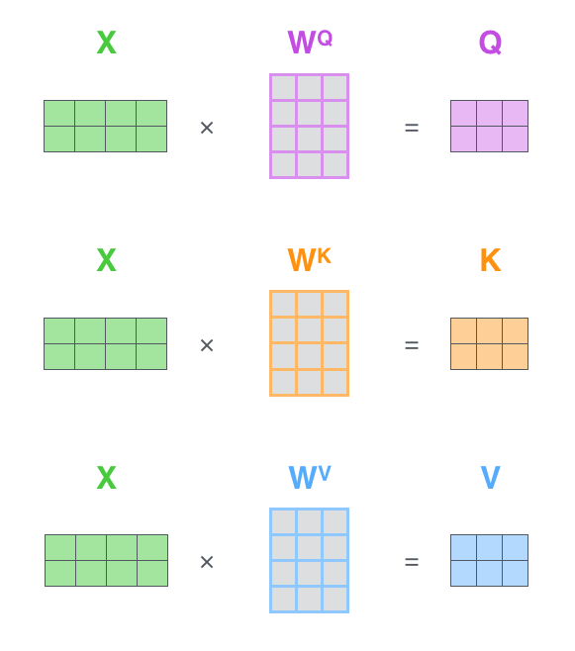
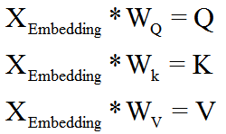
Self-attention in transformer
After we get the X_{Embedding} formed by adding the Positional Encoding and Word Embedding of each word, we need to use this matrix to get three Q、K、V matrices：
Notes:
1、Q-Query, K-Key, V-Value，K、V通常一起出现。在self-attention中，Q、K、V三矩阵是不相同的。
2、因为Wq,Wk,Wv是随机生成的，所以得到的Q,K,V三个矩阵全都不同

Slide 33
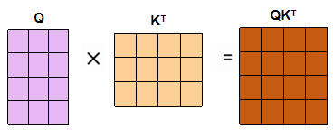
Self-attention
QK^{T} matrices represents the information that each word in a sentence is incorporated into the other words of the sentence.
Dividing QK^{T} by the scaling factor is explained in the article：We suspect that for large values of d_{k} , the dot products grow large in magnitude , pushing the softmax function into regions where it has extremely small gradients .
Notes:
Q与K的转置相乘，会得到每个词与其他词的相似度。

Slide 34
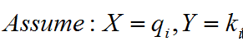
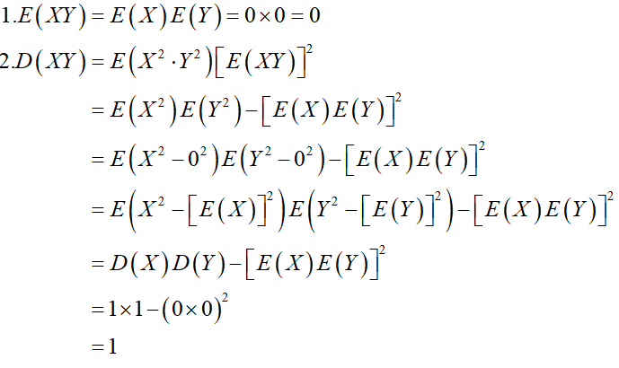
Self-attention
To illustrate why the dot products get large , assume that the components of q and k are independent random variables with mean 0 and variance 1.Then their dot product, has mean 0 and variance d_{k} .
Notes:
这里给出了具体的理论证明
Next prove this conclusion. The default Q and K are independent random variables obeying the standard normal distribution,
then we can get: here suppose X = Qi, Y = Kj.

Slide 35
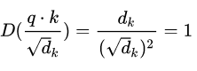
Self-attention
So there are q*k mean E(q*k)=0, variance D(q*k)=d_{k.}
Then a natural method is to stabilize the variance to 1, and the method is to divide the dot product by
By controlling the variance to 1, the problem of the disappearance of the gradient is effectively controlled.
Notes:
对于d_k很大时，点积得到的结果维度很大，使得结果处理softmax函数梯度很小的区域。

Slide 36
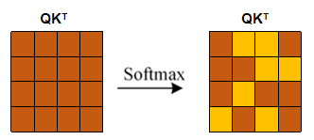
Self-attention
This completes the scaled operation and then performs the mask operation. The mask operation here is the Padding Mask.
Then use Softmax to calculate the attention coefficient of each word for other words.
Notes:
1、The operation structure of the Padding mask is to align sequences of different lengths. The specific method is to add a very large negative number to the position to be filled, so that in the softmax calculation, the position of the padding can be regarded as 0.

Slide 37
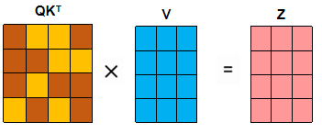
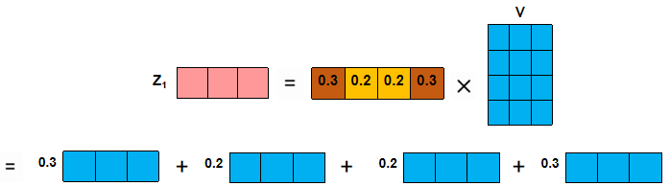
Self-attention
After obtaining the Softmax matrix, it can be multiplied with V to get the final output Z.
A certain line of Z indicates that the attention coefficient relationship of some information between a certain word and all words is obtained:
Notes:
Z的某一行也就表示也就得到了某个单词和所有单词之间部分信息的 attention 系数关系

Slide 38
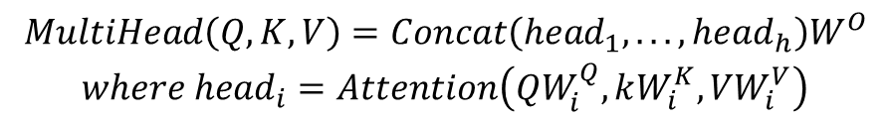
Multi-head attention
$$\begin{matrix}MultiHead\left(Q,K,V\right)=Concat\left(head_{1},...,head_{h}\right)W^{O} \\ where head_{i}=Attention\left(QW_{i}^{Q},kW_{i}^{K},VW_{i}^{V}\right)\end{matrix}$$
Multi-head attention allows the model to jointly attend to information from different representation subspaces at different positions.
Notes:
1、muiti-head attention可以允许模型在不同的表示子空间里学习到相关的信息。
例如：对The animal didn't cross the street because it was too tired.
采用self-attention，it可以与animal产生联系，若使用multi-head attention，it可以与animal和tired产生联系，从而获得更多信息。
2、Transformer中muiti-head attention有三种不同的形式：第一种：encoder中的muiti-head attention；第二种：encoder-decoder attention；第三种：decoder中的muiti-head attention
3、The result of each of those parallel computations of attention is called a head.
4、

Slide 39
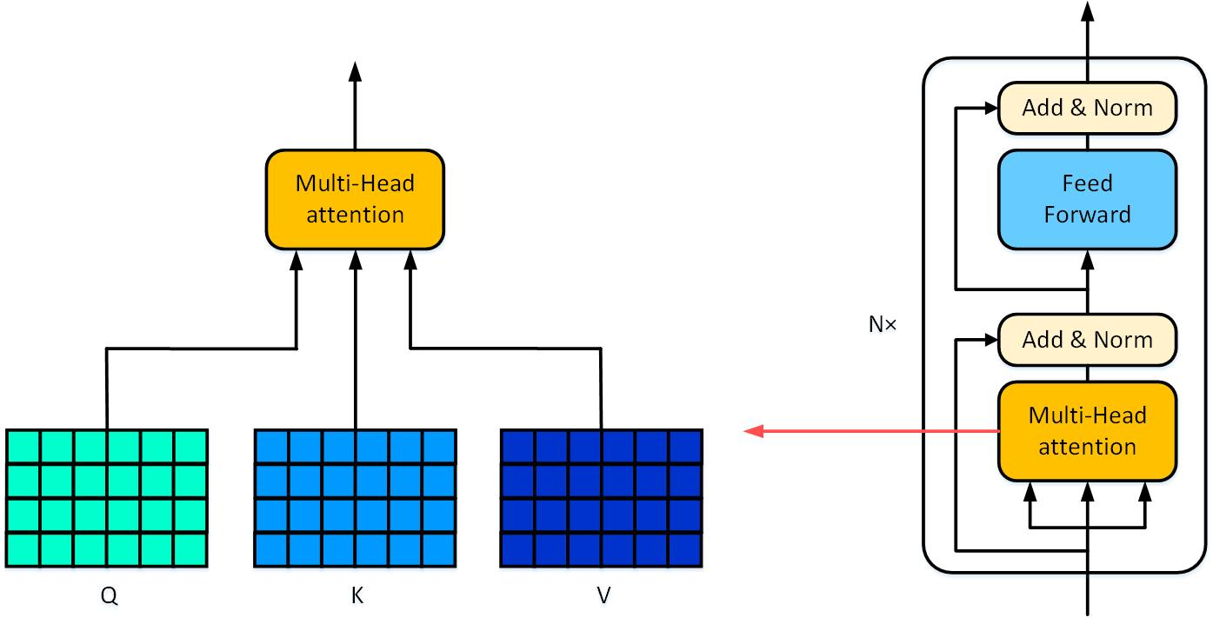
Multi-head attention
Q, K, V represent the three input matrices of muiti-head attention.

Slide 40
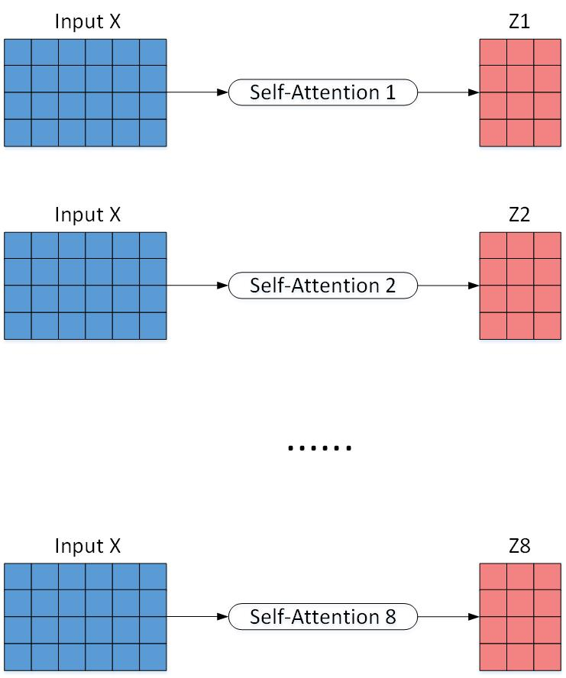
Multi-head attention
On each of these projected versions of queries, keys, and values we then perform the attention function in parallel, yielding dv-dimensional output values.
First, the input X is passed to h different Self-Attentions, and the h output matrices Z are calculated.
The figure below is the case when h = 8, and 8 output matrices Z will be obtained.
Notes:
1、论文中，d_model=512, h=8。所以scaled dot-product attention里面的d_k=d_v=d_model/h=512/8=64。

Slide 41
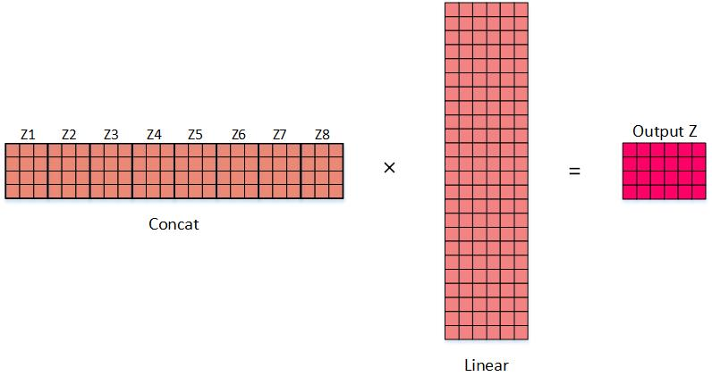
Multi-head attention
After getting 8 output matrices Z1 to Z8, Multi-Head Attention connects them together (Concat), and then passes in a Linear layer to get the final output Z of Multi-Head Attention.
Notes:
1、concat连接的方法是直接将矩阵Z1-Z8连接起来。然后做一个线性变换，得到与Input维度相同的输出矩阵。

Slide 42
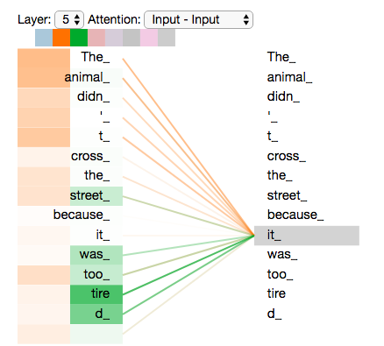
Representation subspace
When we translate a sentence like “The animal didn’t cross the street because it was too tired.”，we would want to know which word “it” refers to.
As we encode the word “it”, one attention head is focusing most on “the animal”, while another is focusing on “tired”.

Slide 43
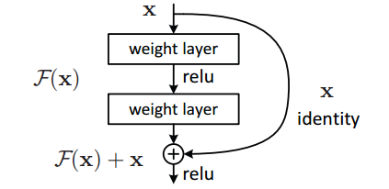
Add & Norm
Residual Connection:
Assume that the output F (x) of a layer in the network after acting on the input x, then after adding a residual connection, it becomes: F (x) + x, this “+ x” operation is a shortcut.
Add in Add & Norm in the transformer architecture diagram refers to this.
Notes:
1、残差连接，即将函数的输出矩阵与输入矩阵相加。
2、So what good is the residual structure? Obviously: because an additional term is added, when the network of this layer seeks the partial derivative of x, there is an additional constant term 1, so the gradient multiplication will not cause the gradient to disappear during the back propagation.

Slide 44



Add & Norm
Layer Normalization is equivalent to normalizing all the data in a sample.
At the same time, LN can be used well in sequential networks such as RNN.
The formula for calculating layer normalization is basically the same as the formula for batch normalization.
$$μ^{l}=\frac{1}{H}\sum_{i=1}^{H}{α_{i}^{l}}$$
$$σ^{l}=\sqrt{\frac{1}{H}\sum_{i=1}^{H}{{\left(α_{i}^{l}−μ^{l}\right)}^{2}}}$$
$$x_{i}^{′}=\frac{x_{i}−μ}{σ}$$
Notes:
1、LN，Layer Normalization，即对矩阵的每一层进行标准化，首先计算出平均值和方差，然后计算矩阵中每一个数值的标准值。
2、batch 批次，批量

Slide 45



Feed forward network
In each sublayer, the Multi-Head Attention layer is connected to an FFN layer, the formula is this:
FFN is equivalent to mapping the Attention result of each position to a feature space of a larger dimension, then using ReLU to introduce non-linearity for filtering, and finally recovering back to the original dimension.
Notes:
1、该层比较简单，是一个全连接网络，包含两个线性变换和一个非线性函数。
2、FFN等效于将每个位置的Attention结果映射到较大维度的特征空间，然后使用ReLU引入非线性进行滤波，最后恢复到原始维度。

Slide 46

Masked Multi-head attention
Different from the multi-head attention of the encoder, to prevent current word generation from becoming dependent on future words, the prediction about position i only depend on the known outputs in front of position i.
Notes:
1、Transformer模型中有两种mask。分别是padding mask和sequence mask。其中，padding mask在所有的scaled dot-product attention里都需要用到，而sequence mask只在decoder的self-attention中用到。
2、mask的作用旨在在翻译的过程中，对一个词的翻译只能基于出现在这个词之前的翻译结果，避免对后面翻译的词产生依赖。
3、These Multi-head attention in the encoder and the decoder have the same working principle.

Slide 47
Masked Multi-head attention
How to mask：
As shown in the figure, generate a mask matrix.
Use the same method as Multi-head attention to get the QK^{T} matrix.
We do the dot-product with the QK^{T} and the mask matrix
Notes:
1、和Multi-head的方法相同：1.通过输入矩阵求得QKV 2.Q和KT乘得到每个词对于其他词的注意力 3.在softmax之前，先对QKT和mask矩阵（黄色部分为0）进行点乘，得到mask QKT其中对应位置也为0，在计算softmax时不影响最终计算结果，产生屏蔽效果。
2、此外，在transformer中的三种attention计算中，也应用了padding mask。因为每个批次的输入序列长度是不一样的，所以我们要对输入序列进行对齐。具体来说，就是给较短序列后面填充0。因为这些填充位置，其实没有意义，所以我们的attention机制不应该把注意力放在这些位置上，所以我们需要进行一些处理。具体做法是：把这些位置的值加上一个非常大的负数(可以是负无穷)，这样的话，经过softmax，这些位置的概率就会接近0。

Slide 48

Encoder-Decoder attention
In the Multi-head attention layer of the encoder, the three input matrixes(Q、K、V) all come from the previous encoder’s output.
In the decoder, the input matrixes(K、V) come from the sixth encoder’s output, and the input matrix(Q) comes from the output of the masked Multi-head attention.
Notes:
1、和encodeer中的工作原理相同，但是decoder中的multi-head的QKV来源和encoder中的有所区别，decoder中的Q来源于上一层decoder，KV来自于encoder的最终输出，即计算目标语言的源语言之间注意力的分。

Slide 49

Linear+Softmax
After the sixth decoder output a vector, the vector will be sent into the linear layer.
Then these scores be input softmax layer to get the probability of next word.
Notes:
1、在最后的decoder输出后，我们得到的是几个向量，我们要怎么将向量转化成目标语言的单词，要经过linear和softmax。
2、linear是一个全连接神经网络，把decoder输出的向量（假设512维），进行升维，如果系统学习了10000个单词就是10000维。其中每一维的数都是这10000个词所对应的得分。
3、decoder输出矩阵经过linear后会映射到一个词库中，然后经过softmax选出词库中概率最大的值。
4、The linear layer is a fully-connected neural network. It makes the vector map to a higher dimensional vector(If this model learn 10000 words, this vector will be a 10000 dimension vector). Each dimension of this vector is a score of each word.

Slide 50

Softmax
In machine learning especially in deep learning，Softmax is an useful function . It maps the inputs to real numbers between 0 and 1,and make sure the sum of these real numbers is 1.
Notes:
1、softmax函数可以将得到的值映射到（0，1）。
2、把linear中的得到的分数输入linear，转化成概率，即下一个词是这10000个词中哪一个的概率。

Slide 51

Dynamic flowchart
Next we show a simplified transformer model that translates French to English.
The encoder and decoder have only two layers of loops.
For example, “je suis étudiant”→“I am a student”
Notes:
Transformer动态演示：法语-->英语。
首先输入一句话“ je suis étudiant ”，然后将这三个单词转化为向量，并与其positional encoding相加，得到embedding with time signal作为encoder的输入。
每个encoder包含两个子层—multi-head attention、feed forward network。
经过两次encoder之后，得到信息矩阵Z。Z乘以WK、WQ后得到decoder的两个输入K、V。另一个输入Q由decoder的masked multi-head attention获得。
此处需要注意的是，masked multi-head attention的输入与decoder的multi-head attention有所不同，其为 “ <begin> je suis étudiant ”

Slide 52

Dynamic flowchart
Notes:
第一次decoder结束后，会得到‘Je’的翻译结果‘I’，此时，decoder的输入变为’ <begin> I ’，然后继续执行decoder操作，依次类推，最后得到翻译结果‘ I am a student’。

Slide 53

Dynamic flowchart
Notes:
第一次decoder结束后，会得到‘Je’的翻译结果‘I’，此时，decoder的输入变为’ <begin> I ’，然后继续执行decoder操作，依次类推，最后得到翻译结果‘ I am a student’。

Slide 54

Dynamic flowchart
Notes:
第一次decoder结束后，会得到‘Je’的翻译结果‘I’，此时，decoder的输入变为’ <begin> I ’，然后继续执行decoder操作，依次类推，最后得到翻译结果‘ I am a student’。

Slide 55

Dynamic flowchart
Notes:
第一次decoder结束后，会得到‘Je’的翻译结果‘I’，此时，decoder的输入变为’ <begin> I ’，然后继续执行decoder操作，依次类推，最后得到翻译结果‘ I am a student’。

Slide 56
application

Slide 57

Bert
Bert, Bidirectional Encoder Representation from Transformers, is a pre-trained model that uses the encoder part of the transformer. As we can see, the Trm is the encoder block.

Slide 58
Bert
In order to enable the semantic representation of the text output by the model to describe the essence of the language, bert used two innovative methods: Masked LM and Next Sentence Prediction.
Input | [CLS] the man went to [mask] store [SEP] he bought a gallon [mask] milk [SEP]
Label | IsNext
Input | [CLS] the man [mask] to the store [SEP] penguin [mask] are flight ##less birds [SEP]
Label | NotNext

Slide 59

Input
Bert's input consists of three parts : Token embeddings , Segment embeddings and Position embeddings. For example: my dog is cute. He likes playing.
Notes:
Bert输入为两个句子时，开头使用cls，中间用sep作为分隔符，最后使用sep作为结束。

Slide 60

Masked LM
Given a sentence, one or several words in this sentence are randomly erased, and the remaining words are required to predict what the erased words are, as shown in the figure below.
Notes:
Life would be too smooth if it had no rubs in it. 生活若无波折险阻,就会过于平淡无奇。

Slide 61
Masked LM
For the vocabulary that was erased in the original sentence, a special symbol [MASK] was replaced in 80% of the cases, an arbitrary word was replaced in 10% of the cases, and the original vocabulary was left unchanged in the remaining 10%.
percent | Former | later
80% | My dog is hairy | My dog is [mask]
10% | My dog is hairy | My dog is apple
10% | My dog is hairy | My dog is hairy

Slide 62

Next Sentence Prediction
Next Sentence Prediction's task is described as follows: Given two sentences in an article, determine whether the second sentence immediately follows the first sentence in the text, as shown below.
Notes:
在实际预训练过程中，我们从文本语料库中随机选择50%正确语句对和50%错误语句对进行训练，
与Masked LM任务相结合，让模型能够更准确地刻画语句乃至篇章层面的语义信息。

Slide 63

Fine-tunning
For sequence-level classification tasks, BERT directly takes the final hidden state of the first [CLS] token and then adds a layer of weight to predict the softmax label.
Other prediction tasks require some adjustments, as shown in the figure:

Slide 64

Comparison
BERT uses a bidirectional Transformer.
OpenAI GPT uses a left-to-right Transformer.
ELMo uses the concatenation of independently trained left-to-right and right-to-left LSTM to generate features for downstream tasks.

Slide 65
GPT&GPT-2
The same as GPT, GPT-2 is still a one-way language model.
1.GPT and GPT-2 use the decoder of transformer and delete the encoder-decoder attention layer.
2.GPT and GPT-2 use the encoder of transformer and change the Multi-head attention layer to a Masked Multi-head attention.
Model | GPT | BERT | GPT2
Basic Block | decoder | encoder | Decoder
Direction | One-way | Two-way | One-way
Layer | 12 | 24 | 48
parameter | 100Million | 300Million | 1.5Billion
process | Pre-train + fine-tuning | Pre-train + fine-tuning | Unsupervised multitask learn
Notes:
1、GPT和GPT-2都是单向语言模型，单向即对一个词的预测只能基于这个词之前的词，这点和transformer中的decoder相似，事实上也是如此，GPT使用多个transformer的decoder叠加而成，而decoder中的encoder-decoder attention层因为没有encoder而删掉。GPT-2相比于GPT使用了更深的48层transformer（GPT12层、BERT24层），共15亿个参数（GPT1亿、BERT3亿）
2、After thinking, we find that both of these two are the same meaning “a model having a Masked Multi-head attention and a feed forward layer”.

Slide 66


GPT&GPT-2
Notes:
GPT和GPT-2都是单向语言模型，单向即对一个词的预测只能基于这个词之前的词，这点和transformer中的decoder相似，事实上也是如此，GPT使用多个transformer的decoder叠加而成，而decoder中的encoder-decoder attention层因为没有encoder而删掉。GPT-2相比于GPT使用了更深的48层transformer（GPT12层、BERT24层），共15亿个参数（GPT1亿、BERT3亿），相比于GPT和BERT，GPT2没使用传统的预训练+微调的方法，而是使用了一种无监督的多任务学习方式。

Slide 67

GPT&GPT-2
The same as BERT, GPT consists of pre-training and fine-tuning. While GPT-2 delete the fine-tuning layer. Instead of fine-tuning the model for different tasks, GPT-2 does not define what the model should do, and the model automatically identifies what needs to be done.
Notes:
相比于GPT和BERT，GPT2没使用传统的预训练+微调的方法，而是使用了一种无监督的多任务学习方式。GPT-2使用了更大的算力，使得训练出来的模型可以自己识别任务。

Slide 68
Summary

Slide 69
Summary
Advantage：
Transformer has abandoned the most fundamental RNN or CNN in NLP. The use of Multi-Head-Attention is sufficiently innovative and has achieved very good results. It can be applied not only in the field of machine translation, but also in other NLP fields.
Disadvantages:
The position information lost by Transformer is actually very important in NLP. The addition of Position Embedding to the feature vector is only a remedy, and does not change the inherent defects in the Transformer structure.

Slide 70
THANKS

Slide 71


Slide 72



